Slide 1
Bellabeat Case Study
Unveiling Insights: Competitor Fitness Usage Data Analysis (Fitbit)
Alex Carran February 2024

Slide 2
Table of Contents
Background
Ask
Prepare
Process
Analyze
Share
Act

Slide 3
Background
Bellabeat, a high-tech company that manufactures health-focused smart products
Bellabeat has grown rapidly and quickly positioned itself as a tech-driven wellness company for women.
Product to compare: Leaf
It is a fitness tracker that is worn as bracelet, necklace, or clip
It is most similar to the Fitbit fitness tracker that we will be reviewing

Slide 4
Ask Phase
Analyze smart device usage data in order to gain insight into how consumers use non-Bellabeat smart devices
Analyzing Fitbit users' smart device utilization could provide valuable insights for Bellabeat to better understand customer behavior and product usage patterns.
Gathering usage insights- reporting to marketing with potential leaf fitness device improvements

Slide 5
Process Phase
Tools used
Excel
Spreadsheets
MySQL
Tableau

Slide 6
Analyze- Limitations
Limitations of Dataset
33 total users in the dataset is a very low sample size
No time of year specifics
season?
No demographic is given for the participants of the survey
Height?
Weight?
Sex?
Age?
Device not worn at all times, may not track all activities.
Not all participants wore their Fitbit device everyday
Lack of consistent data throughout the day

Slide 7
Analyze- Dataset
What data we will be looking at
4 separate csv tables
Daily Activities - level of activity, duration of activity (mins), day of week
Hourly Calories - calories burned per hour
Hourly Steps - steps per hour
Sleep - total mins of sleep

Slide 8
Analyze- Quick Summary
Total Participants for Daily Activity Data: 33
Total Participants for Sleep Tracking Data: 24
Participants with High Use ( >= 21 days): 12
Participants with Fair Use ( >=11, < 21) : 3
Participants with Low Use ( <= 10): 9

Slide 9
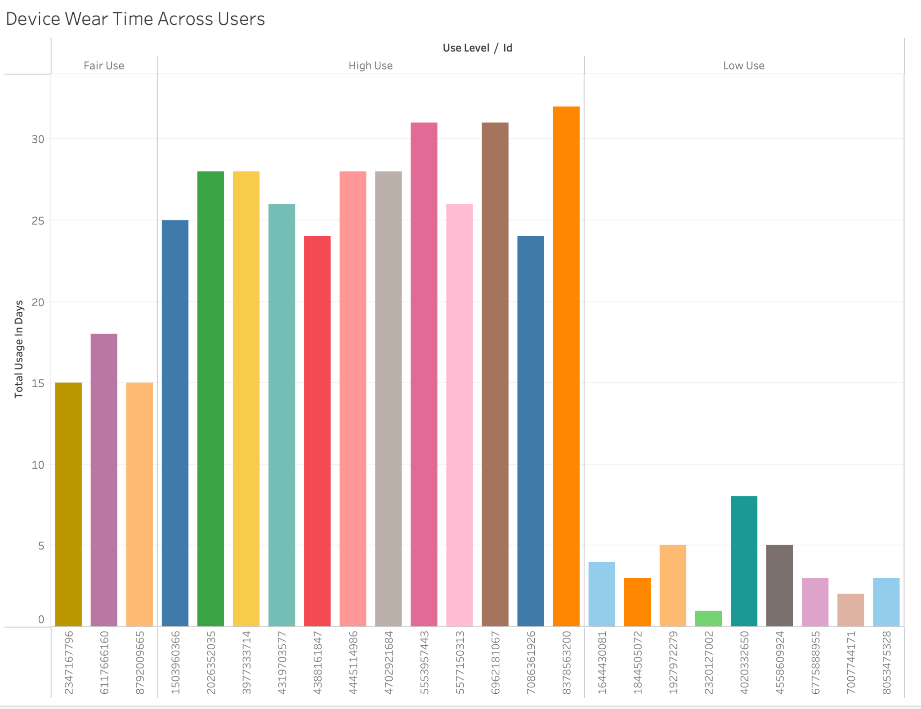
Analyze - Device Wear Time Across Users

Slide 10
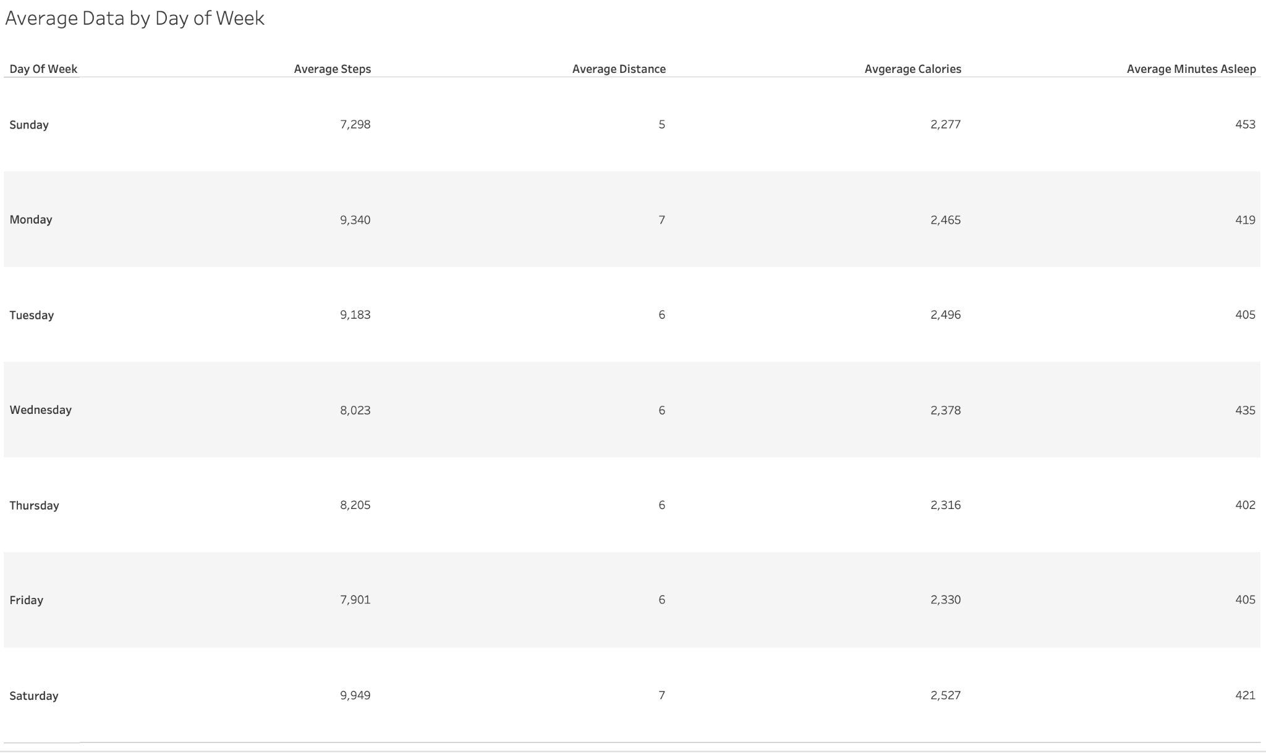
Analyze- Average Data by Day of Week

Slide 11
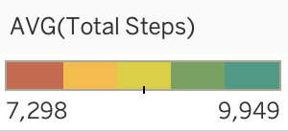
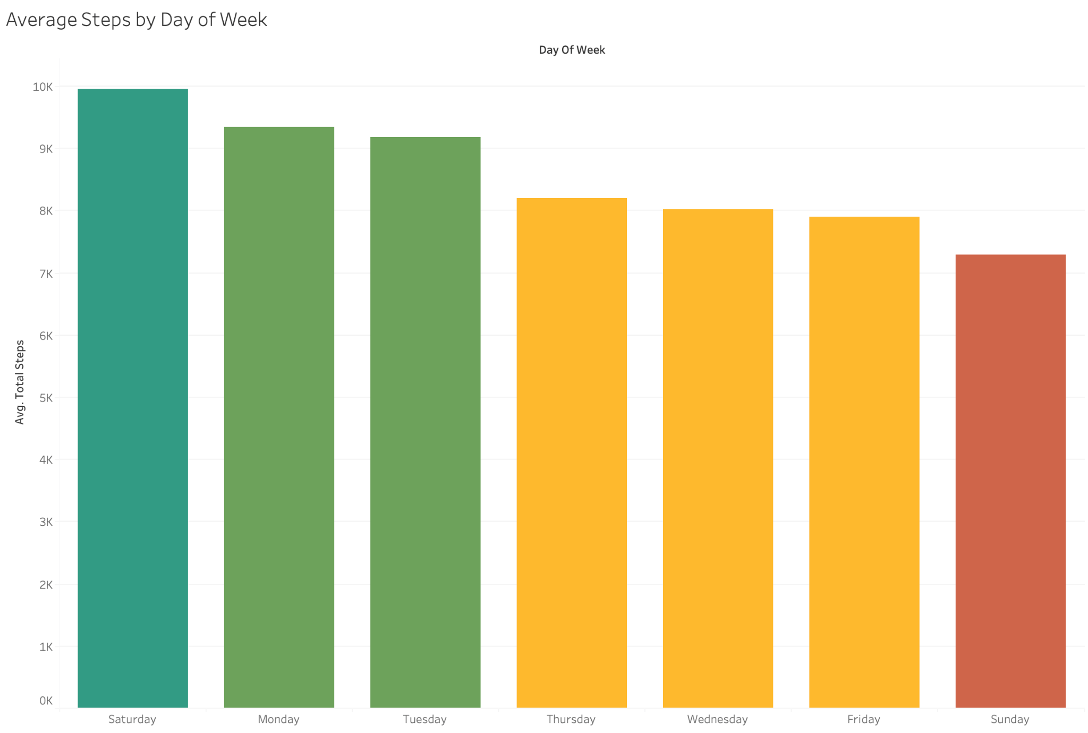
Analyze - Average Steps per Day
Saturday has the maximum number of average steps taken at roughly 10k steps
Sunday had the minimum number of average steps taken at roughly 7.3k steps

Slide 12
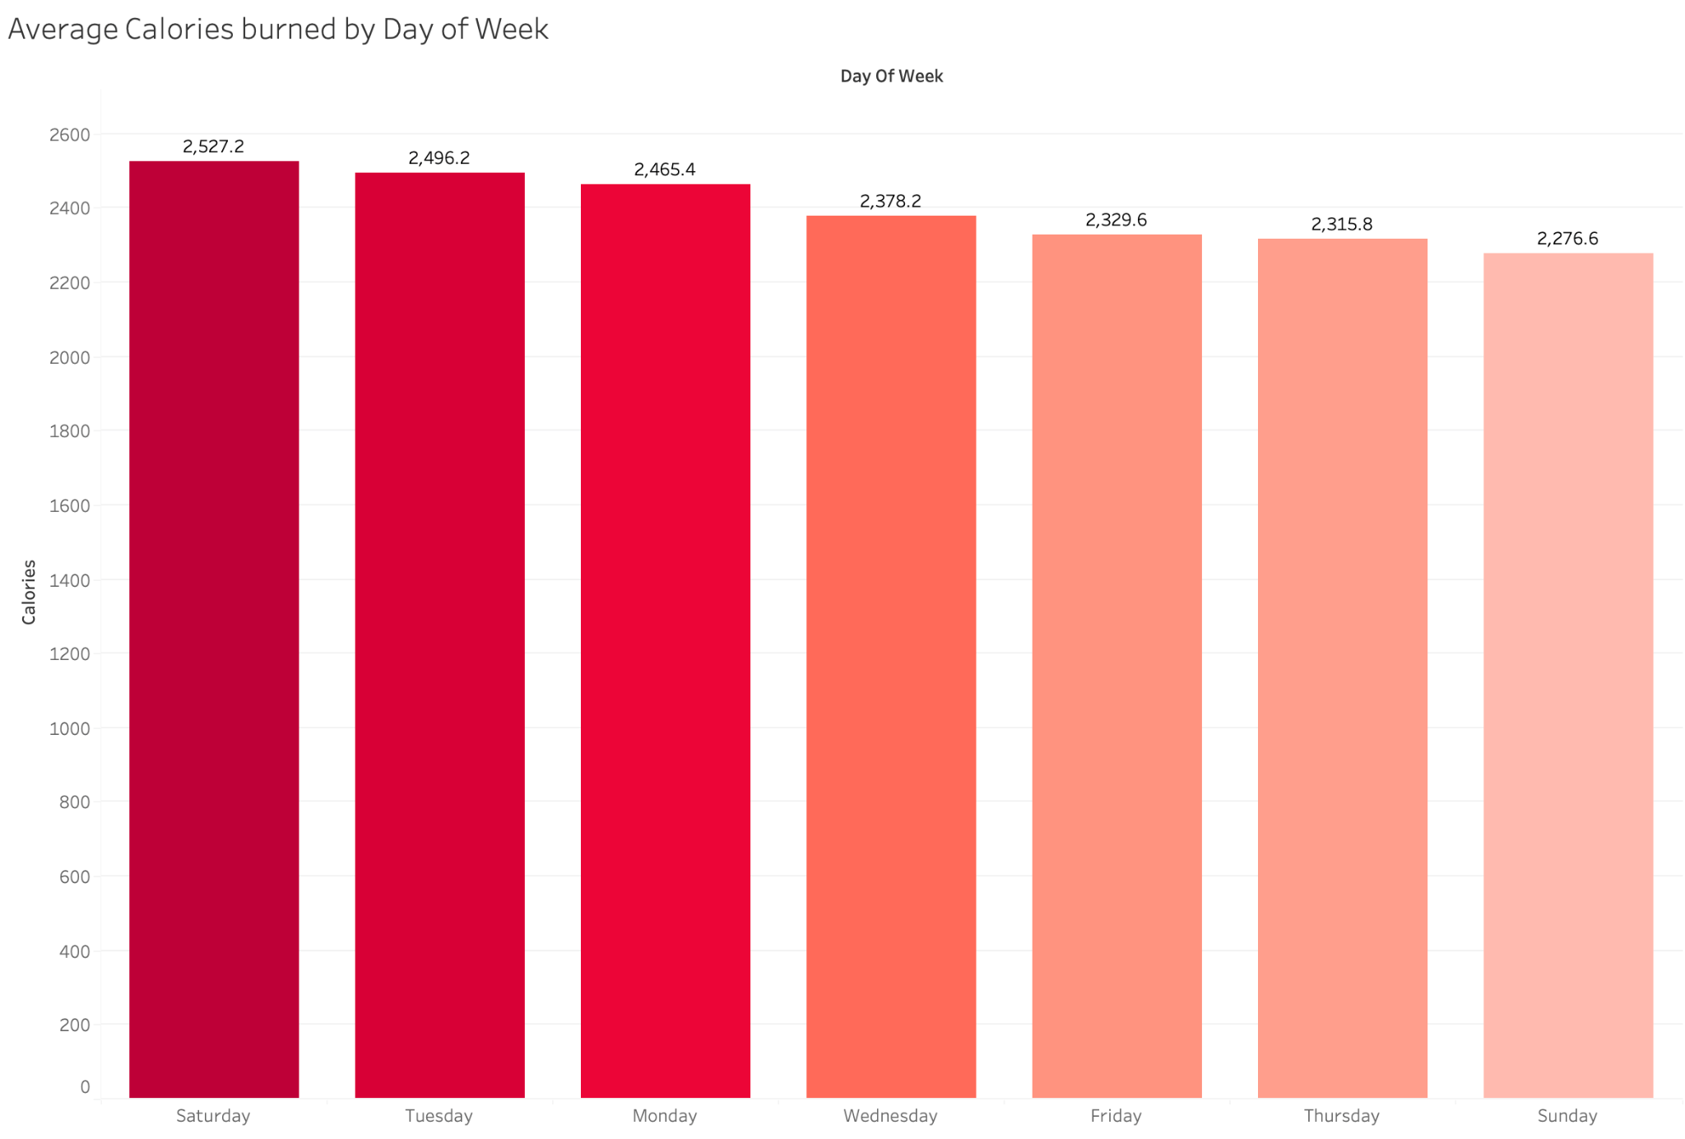
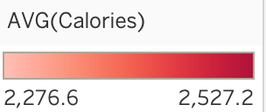
Analyze- Average Calories per Day
On Saturdays, the average number of calories burned peaks at approximately 2,530
Conversely, Sundays exhibit the lowest average calorie burn, hovering around 2,300

Slide 13
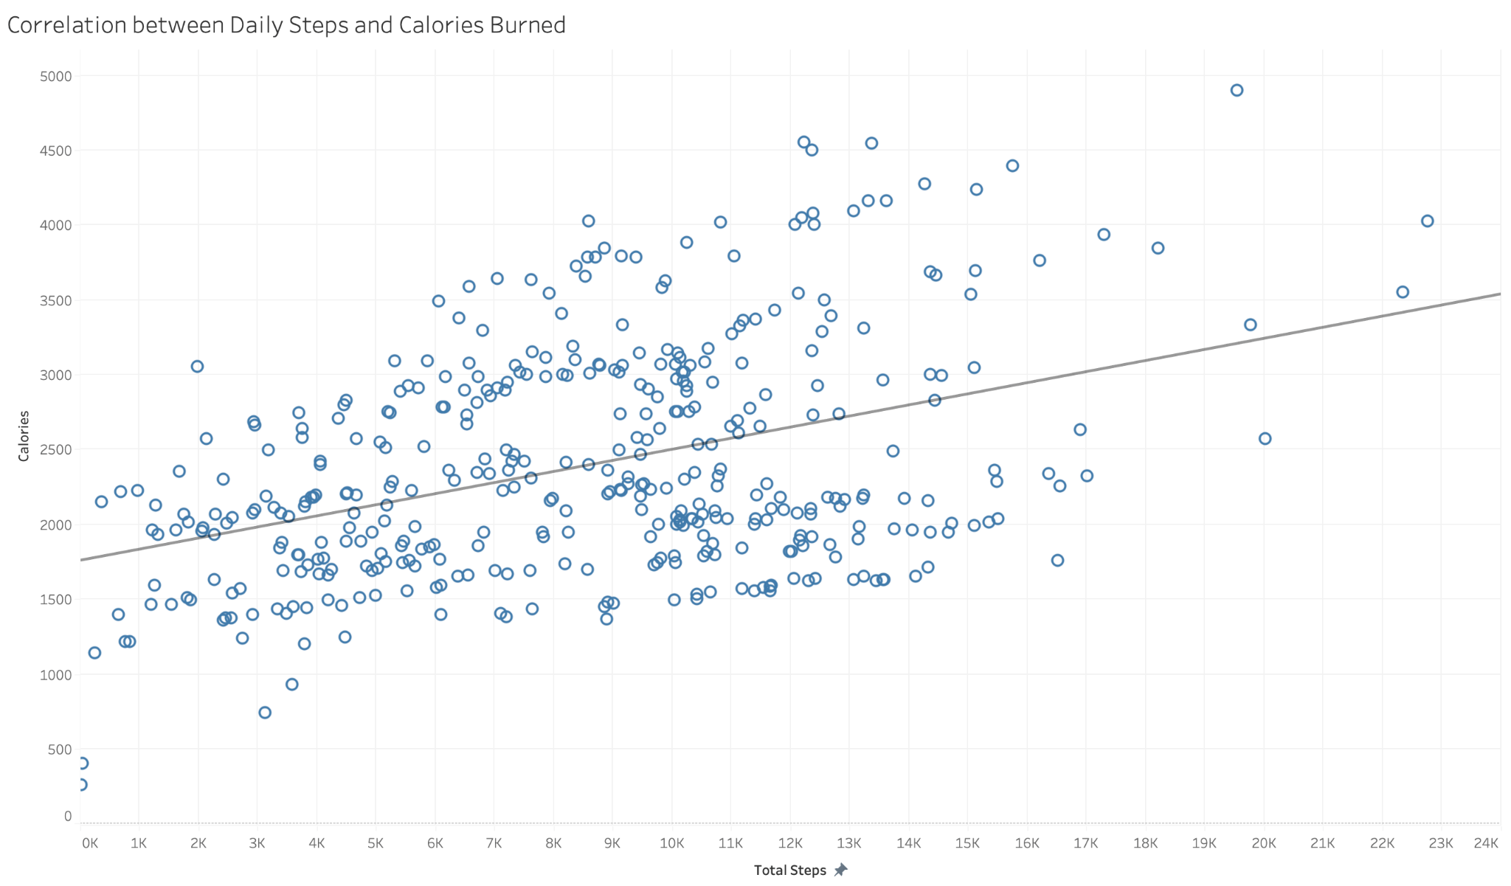
Analyze- Correlation between Steps and Calories
There is a positive correlation between steps taken and calories burned

Slide 14
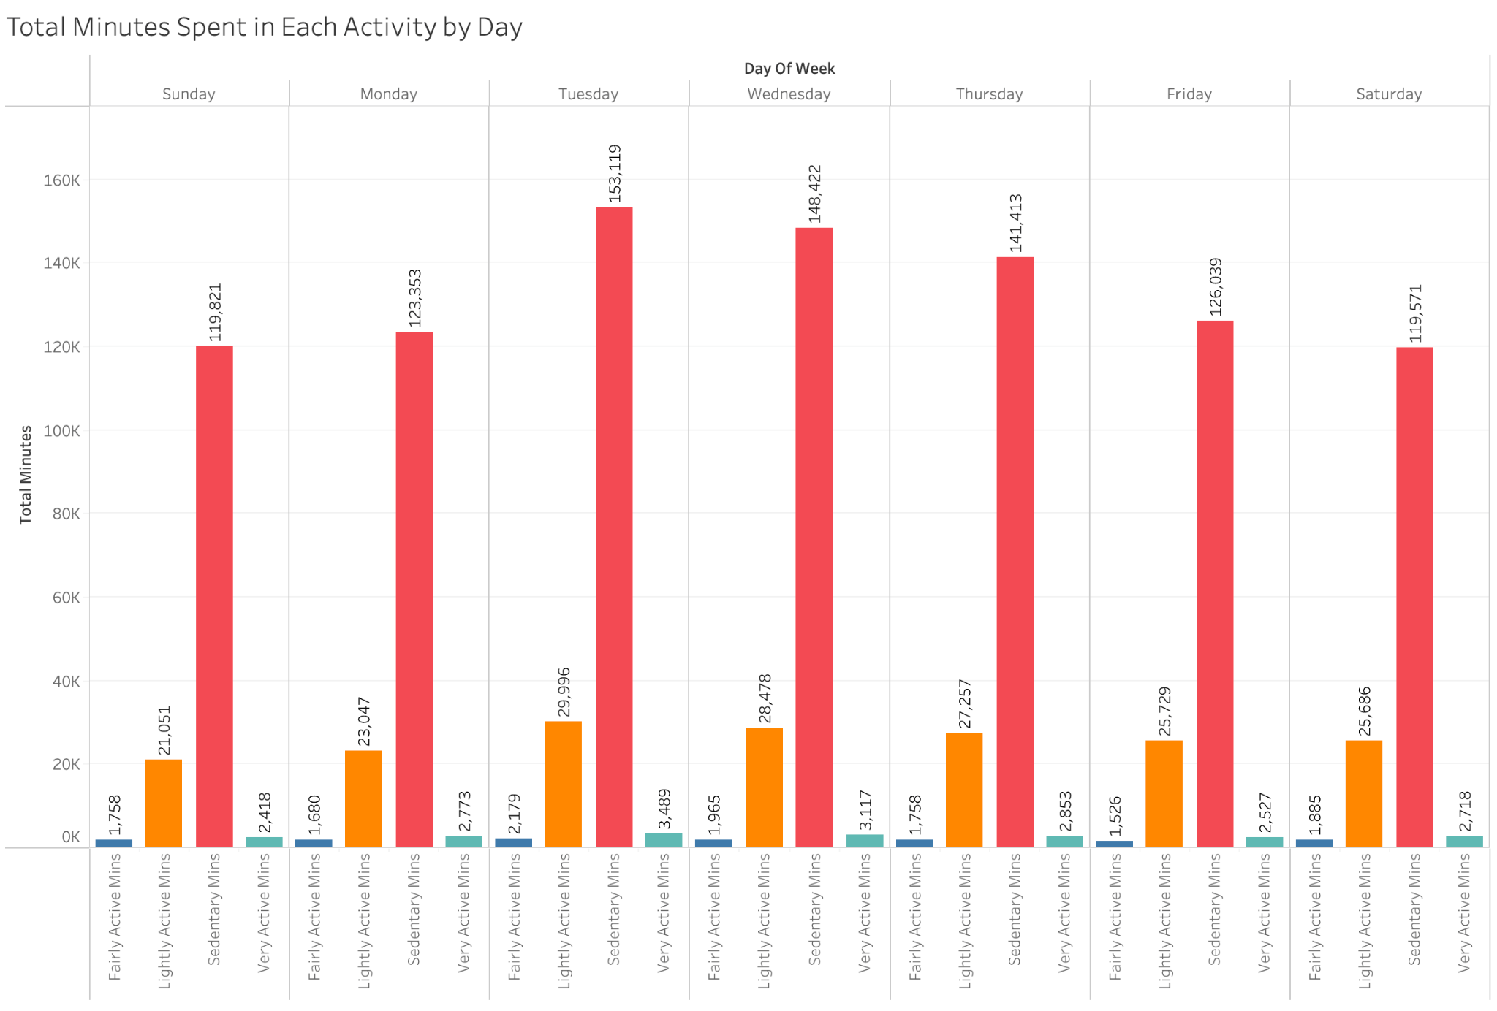
Analyze- Activity Level Breakdown
Sedentary minutes per day significantly exceed other activity levels
Light activity accounts for the second highest duration
Tuesdays and Wednesdays exhibit the highest levels of light activity while Sunday represents the lowest

Slide 15
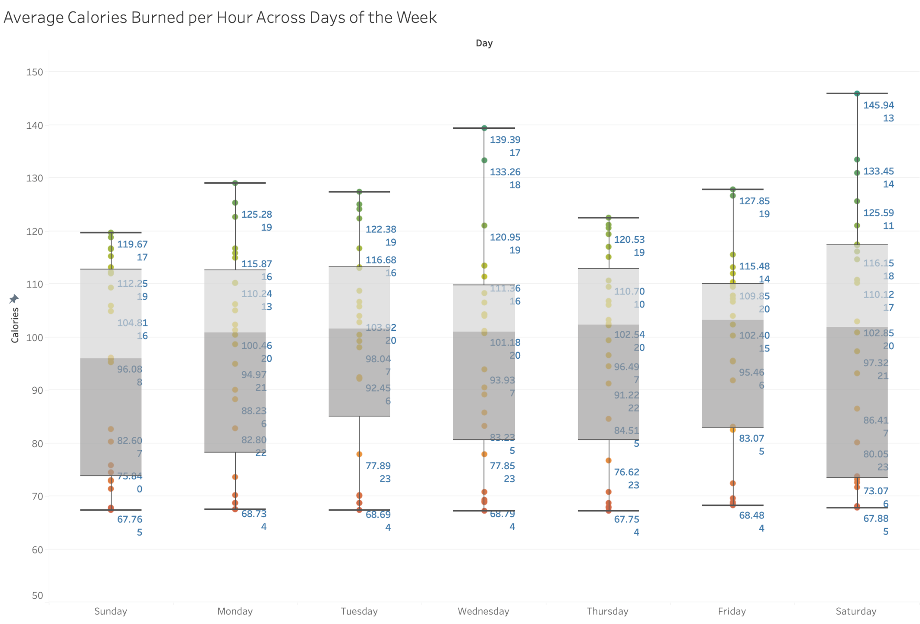
Analyze- Caloric Burn Analysis by Hour and Day
Saturdays peak in calorie burn, particularly at 1pm
Caloric burn is notably low during the early morning hours
Weekday afternoons, especially between 5pm and 7pm, consistently record the highest calorie burn rates

Slide 16
Act- Initial Findings
Users predominantly maintain a sedentary state throughout the day, potentially indicating suboptimal step counts
CDC guidelines suggest 10,000 daily steps for healthy adults; however, our data reveals that average step counts fall short of this target
Sunday emerges as a low-activity day. Consider implementing exercise reminders to encourage user engagement
Furthermore, introducing a goal tracker feature could notify users upon achieving their health milestones

Slide 17
Act- Initial Findings
Insights indicate a positive correlation between step count and calorie burn. Consider sending users notifications to remind them of the health benefits associated with walking
On average, users are falling short of recommended sleep durations. Notably, Sunday records the closest average sleep duration to the recommended 8 hours, with an average of 453 minutes (7 hours and 55 minutes). Implementing a sleep schedule feature may aid users in maintaining healthier sleep habits

Slide 18
Share- Key Insights
Weekday Afternoons (5-7pm): Users are more active, possibly post-work activities
Saturdays (1pm): Peak activity time, likely due to weekend leisure.
Sleep Tracking: Many participants didn't use it, reasons unknown.
Similarity to Fitbit: Bellabeat data aligns, potential marketing synergy.

Slide 19
Act- What should Bellabeat do?
Targeted Timing- Highlight device's activity tracking during peak weekday afternoons and Saturdays.
Weekend Promotions- Offer special deals or challenges on Saturdays to boost engagement
Sleep Tracking- Address barriers, promote importance of sleep tracking
Competitive Edge- Use data alignment with Fitbit to position Bellabeat favorably
Content Tailoring- Create tailored content for users' activity patterns

